Slide 1
NEO – PRICING IAT
2025 April 25

Slide 2
SHIPPING
INFORMATION

Slide 3
Shipping Information
*Shipper = The company sending goods.
*Consignee = A person or company to whom commodities are shipped.Officially, the legal owner of the cargo
*Forwarder = One that forwards, especially an agent that facilitates and assures that passage of received goods to their destination.
*Broker = Prepares all the necessary documentation and makes other arrangement on be haft of a third party for a fee or commission.
*Freight Prepaid = A notation or a bill of lading indicating that transportation freight charges have been paid or paid at the origin.
*Freight Collect = A notation or a bill of lading indicating that freight charges are collected from companies by the delivering carrier.
*Feeder Vessel = Vessel coming/going to the transshipment port.
*Mother Vessel = A vessel where the cargoes are transferred from the feeder vessel to be deliver to its final destination.

Slide 4
Shipping Information
Demurrage = Charges that a shipper or consignee must pay to the carrier for failing to deliver or receive a shipment to/from a storage facility within a prescribe period of time.
Detention = An assessment against cargo when a shipper, consignee or agent has used equipment beyond the specific free time period.
Transshipment = Unload cargo at one point, then reload it for shipment to destination.
Proforma = A document submitted by the shipper which contain the shipper details needed to make a bill of lading.
Manifest = A document listing of the cargo stowed aboard a vessel, usually broken down by port of of unloading; it summarizes the individual bill of lading issued for each consignment and is provided to customers authorities for inspection upon landing.
SOC = “Shipper’s Own Container”, the container is owned by the shipper and only using the service of the company for their shipment.

Slide 5
Shipping Information
Mode of Transport
CY – Container Yard
- Facility where full and empty containers are stored.
CFS – Container Freight Station
- Warehouse facility for loading/unloading less than full container.
Mode of Transport
CY/CY CFS/CFS Door/Door
CY/DOOR CFS/CY
CY/CFS Door/CY
Container Freight Station

Slide 6
Shipping Information
Document Requirements
Booking
- Temperature Setting Requirements – Refrigerated cargo
- DG Declaration – hazardous cargo
Export Processing
- Final Proforma
- Export Cargo Receipt
- Export Declaration (If available)
Import Processing
- One original B/L endorsed by consignee/bank
- Bank Guaranty with counter guaranty
- Container Guarantee
- B/L Surrender or waybill with Company Guaranty
From operation Dept.

Slide 7
Shipping Information
Document Requirements
Receiving
- Shipper’s Export Declaration
- EIR: Equipment interchange receipt ------ E.C.O
- O.R> For Arrastre & Wharfage
- O.R for Shut – out charges paid, if applicable
Delivery
- Container clearance
- AISL clearance (origin – US/Europe/Japan)
- AISL container deposit (AISL- Association of International Shipping Lines)

Slide 8
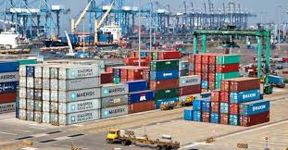
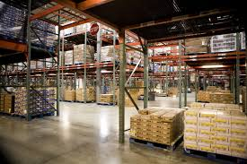
Shipping Information
Document Requirements
Receipt of freight payment
Deliver Order (if being processed by forwarder)
Valid Identification (if the cargo is personal effects)
Terms Used in Operations
Container Terminal - Area were large scale container handling and storage facilities are available.
Consolidate - To combine more than one shipment in a container for more than one consignee or shipper.

Slide 9
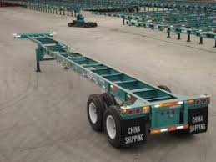
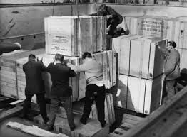
Shipping Information
Terms Used in Operations
Chassis- A frame with wheels and container locking devices
        in order to secure the container movement
Dangerous Goods- The term used for hazardous cargoes.
Depot – Container Freight Station or designated area where
    empty container can be pick up
        EIR – Equipment Interchange Receipt; a document transferring a container from one carrier to another, or to/from a terminal.
        Stowage Plan - Diagrammatic sketch of vessel showing location of cargo as stowed in the vessel hold (s).
        Stevedore - Individual or firm that employs longshoremen and who contract to load or unload the ship.

Slide 10
Shipping Information
Terms Used in Operations
- Stripping- Removing cargo from a container (devanning)
Stuffing – Putting cargo into container
Wharfage - Charge assessed by a pier or dock owner against freight handler over the pier or dock or against a steamship company using the pier or dock.

Slide 11
Shipping Information
Mode of Shipment
Full Container Load (FCL)
- Refers to the containers filled with goods that are packed or unpacked
by the shipper at his risk and expenses
- Shipping company receives FCL cargo at CY or at the shipper’s door and
delivers it at the consignee’s door or CY
Less Container Load (LCL)
- Small lot cargo and cargo requiring special techniques in loading into container
are received at the CFS and LCL cargo and are packed into the container with
the shipping company assuming responsibility.

Slide 12
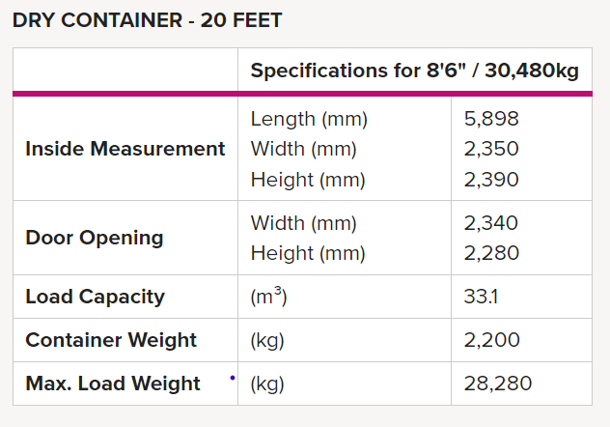
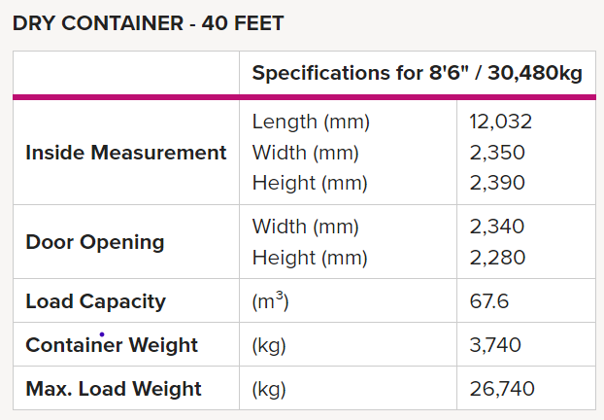
Shipping Information
Container Type

Slide 13
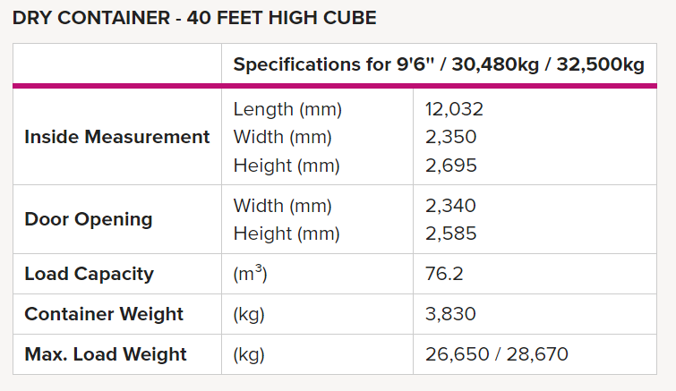
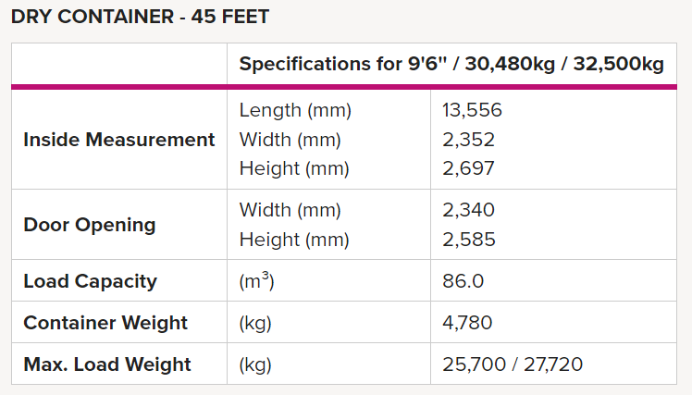
Shipping Information
Container Type

Slide 14
Shipping Information
Container Type
Special Type of Container
1. OPEN TOP
- A canvas Cover is used as the ceiling of the container
permitting the use of a crane to load and unload.
- Over-height cargo can be loaded
- Rings are imbedded into the floor which provide
good lashing for machinery.
- can be 20 / 40 / 45’ container.
Special Type of Container
2. FLAT RACK
- Cargo can be loaded into this container from either
end or from top.
- This is best suited from machineries
- This container has no ceiling

Slide 15
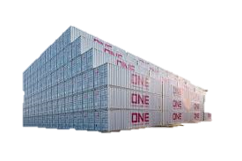
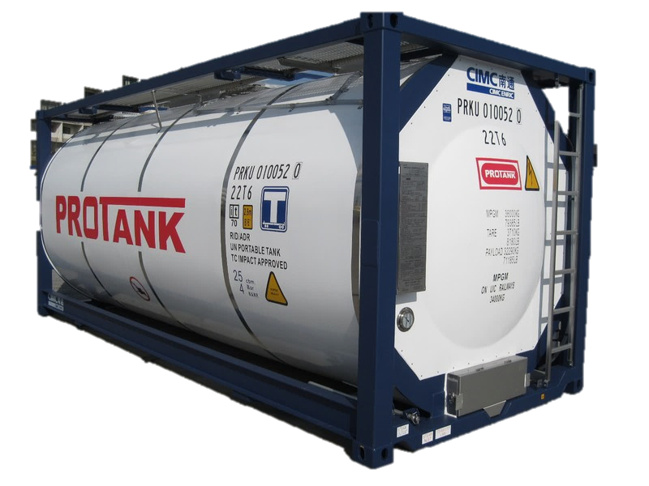
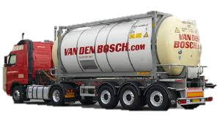
Shipping Information
Special Type of Container
3. REEFER CONTIANER
- The temperature can be set between +25C & -25C
- The designated temperature can be maintained
throughout
the entire transit by means of the refrigeration unit.
Container Type
Special Type of Container
4. TANK CONTAINER
- Tank with an iso-frame; liquid cargoes in bulk
including foodstuffs & hazardous cargoes

Slide 16
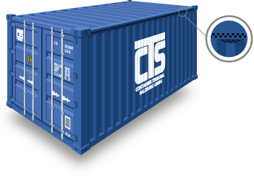

Shipping Information
Container Type
Special Type of Container
5. VENTILATED
- Slide vents along top and bottom rails; for hygroscopic cargoes e.g. coffee, cocoa
tobacco.

Slide 17
Shipping Information
DEPOTS
Cargo is delivered to a central facility called a depot, where freight can be carefully packed and consolidated into a container by agents externally contracted by the shipping line, reducing confusion and avoiding the potential for damage or theft of goods by one of the other suppliers. Likewise, when the shipment reaches its destination, it must pass through a depot, where the container can be deconsolidated back into individual shipments, ready for pickup.
TERMINALS
Whenever a container is changed from one method of transport to another, it is referred to as ‘changing the mode’, and a container terminal is any location where this change takes place — for instance, a container that is being hauled on the roads by a truck can then be placed onto a train and travel by rail.
YARDS
Container yards, quite simply, areas of storage for empty containers. After a container has been deconsolidated at a depot (or unloaded directly by the importer), they are relocated to a yard where they are stored until their next assignment.

Slide 18
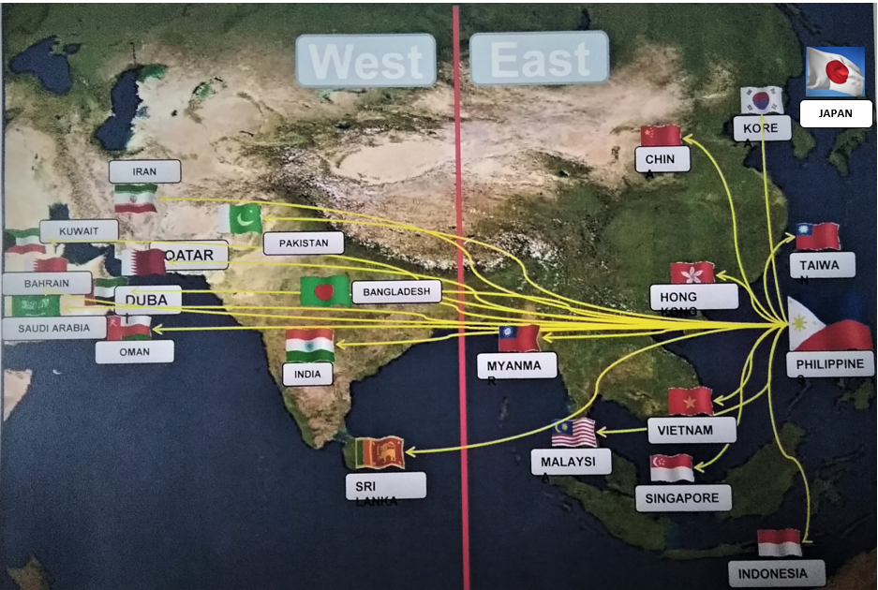
Shipping Information

